Slide 1
SUMMER TRAINING PROJECT
Candlestick Pattern Recognition
using Computer Vision and Machine Learning
[Milroman Singh
Abhijeet Singh
Jashanpreet Singh
Jaspreet Singh]
[Group 4]
Summer Training Program, 2026
01

Slide 2
What we'll cover
From problem statement to a deployed, tested application
1
Problem statement & objectives
5
Model comparison & results
2
Dataset generation (rule-based labeling)
6
Prediction pipeline & GUI
3
Computer vision pipeline
7
Testing, limitations & future scope
4
Feature engineering
02

Slide 3
Objective
01
Input
02
Detect
To extract a live stock chart for further analysis
To identify individual candlesticks formations in the extracted chart
03
Classify
04
Signal
To detect and match shape of chart and classify its candlestick pattern
Output a Bullish / Bearish / Neutral trading signal

Slide 4


Problem statement & objectives
The problem
Objectives
Manually scanning stock charts for candlestick patterns is slow, tedious, and prone to human error — especially for traders still building pattern-recognition intuition.
Detect individual candlesticks from a chart image
Extract geometric features (body, wick ratios)
Classify 6 candlestick patterns via ML
Compare SVM, Random Forest, Decision Tree, KNN
Support image upload AND live ticker input
Deploy via a Streamlit web interface
This project automates the process end-to-end: given a chart image or a stock ticker, the system detects the candlestick(s), classifies the pattern, and returns a trading signal.
03

Slide 5
Scope — six patterns, precisely defined
Every pattern is defined mathematically from body-to-range and wick ratios — not eyeballed.
Doji
Hammer
Shooting Star
Neutral
Bullish
Bearish
Spinning Top
Bullish Engulfing
Bearish Engulfing
Neutral
Bullish
Bearish
04

Slide 6



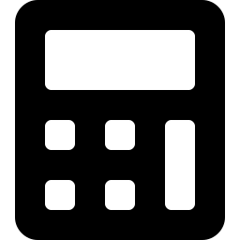


Technology stack
OpenCV
yfinance
mplfinance
Detection & preprocessing
Historical OHLC data
Chart rendering
scikit-learn
Pandas / NumPy
Streamlit
SVM, RF, DT, KNN
Data handling
Web GUI
05

Slide 7



System pipeline
Both input modes converge into one shared detection and classification pipeline.
Image / Ticker input
Preprocessing
Candlestick detection
Feature extraction
Random Forest model
Prediction & signal
06

Slide 8
Dataset generation
Labeled without manual tagging
Historical OHLC data pulled via yfinance across 13 tickers (NSE + US)
Each pattern has a precise mathematical rule (body/wick ratios)
Matching candle windows rendered as chart images with mplfinance
Randomly sampled to ~200 balanced images per class
1,200
labeled chart images
6 classes × ~200 images
Example rule — Doji: body / range < 0.1
6-candle window per image — pattern always in the last 1–2 candles
07

Slide 9
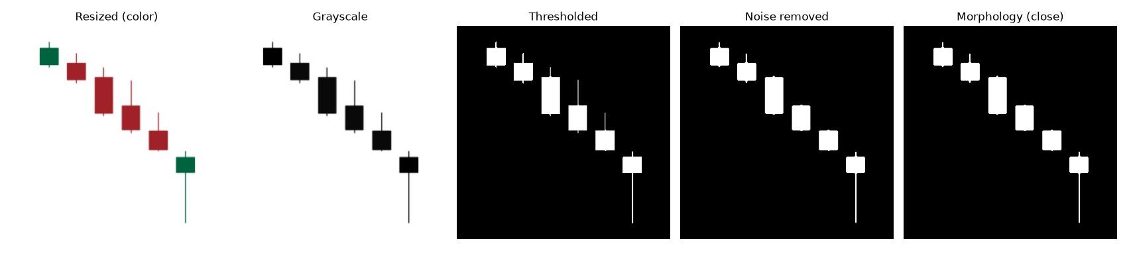
Preprocessing & candlestick detection
Grayscale → threshold → noise removal → contour detection → body/wick split by row-width scan
Actual output from the project's OpenCV pipeline, run on a generated Hammer sample.
08

Slide 10
Feature engineering
Pixel measurements are converted into scale-invariant ratios — the same style used to define the rules.
body_ratio
upper_wick_ratio
body / range
upper_wick / range
lower_wick_ratio
wick_to_body_ratio
lower_wick / range
(upper_wick + lower_wick) / body
Computed for the last two candles in every image → a fixed 11-column feature vector for all 6 classes
09

Slide 11
Model comparison
Four classical ML models trained on an 80/20 stratified split.
10

Slide 12

Results & key findings
Tree-based models outperformed SVM & KNN — consistent with features engineered from threshold-based rules
Doji was the most-confused class, traced to pixel-measurement noise near its tight body-ratio boundary
96.3%
F1-score
Sub-2-second prediction latency confirmed via automated performance testing
Random Forest — final model
Error handling verified: missing files, corrupted files & blank images all fail safely with clear exceptions
Best balance of accuracy, precision & recall across all 4 models tested
11

Slide 13
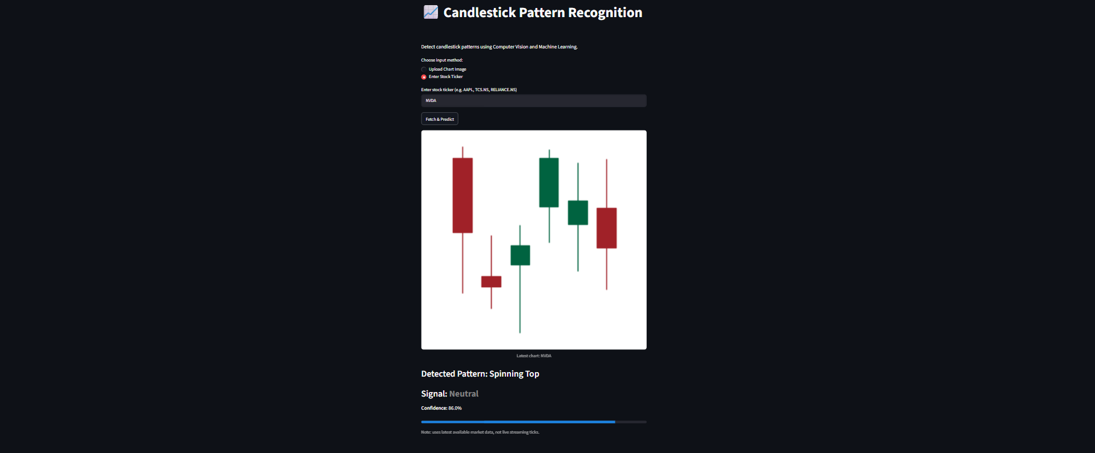

Prediction pipeline & GUI
Upload chart image
Direct screenshot input
Enter stock ticker
Fetches latest data & renders chart
Both modes converge into the same detection + classification pipeline, then return: pattern, signal, and confidence.
Live Streamlit app — ticker mode
12

Slide 14


Testing & validation
Unit tests
Pattern-labeling rules verified against known geometric cases
Consistency checks
Detected body + wicks always sum to the full candle range
15 / 15
Edge cases
automated tests passing
Missing files, corrupted files & blank images all fail safely
pytest suite covering rules, detection, edge cases & latency
Performance
Prediction latency confirmed under the 2-second target
13

Slide 15

Limitations & future scope
Known limitations
Future scope
Assumes a light chart background — dark-themed screenshots invert the thresholding logic
Uploaded images should show ~6 candles at training-like zoom; full multi-month charts distort feature ratios
Ticker data reflects latest available prices, not live streaming ticks
Trend context (e.g. prior downtrend) is not yet considered
Adaptive background detection for light/dark themes
Trend-context awareness before classifying reversals
Add a chatbot
Multi-candle patterns (Three White Soldiers, Morning/Evening Star)
Benchmark against a CNN-based deep learning approach
Expand the library to cover 30+ candlestick formations
14

Slide 16
Thank you
A complete Computer Vision + Machine Learning pipeline — from rule-based labeling to a deployed, tested application.
Questions?
15

